Slide 1
abcdefghijklmnopqrstuvwxyz1234567890=_+{[}]#~’@;:/?.>,<|\`¬*
Analysing a Slot Machine Bonus Game
abcdefghijklmnopqrstuvwxyz1234567890=_+{[}]#~’@;:/?.>,<|\`¬*
i
i
i
i
i
i
Check in R
Slot Machines
abcdefghijklmnopqrstuvwxyz1234567890=_+{[}]#~’@;:/?.>,<|\`¬*
Jack Jordan

Slide 2
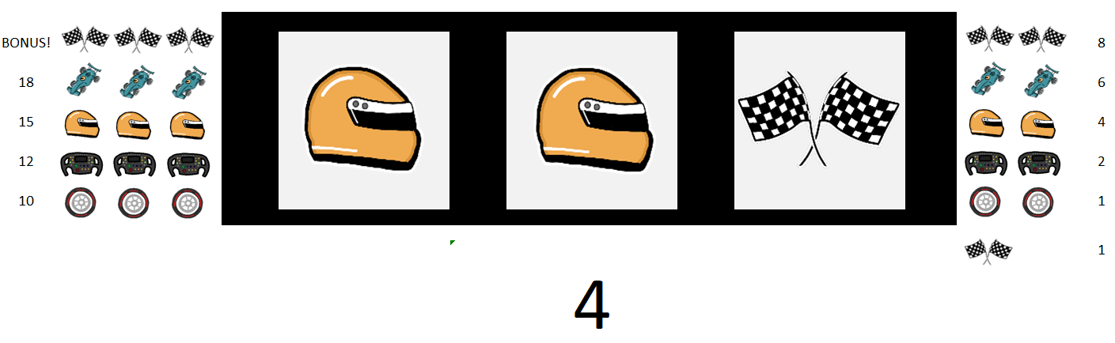
B
A
B
abcdefghijklmnopqrstuvwxyz1234567890=_+{[}]#~’@;:/?.>,<|\`¬*
abcdefghijklmnopqrstuvwxyz1234567890=_+{[}]#~’@;:/?.>,<|\`¬*
i
i
i
i
i
i
Check in R
Bonus Game
C
Slot Machines
A: Reels
B: Winning Combinations
C: Pay-out Amount
abcdefghijklmnopqrstuvwxyz1234567890=_+{[}]#~’@;:/?.>,<|\`¬*

Slide 3
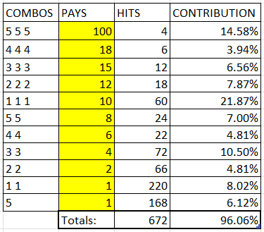
Problem:
Create a bonus game
Desired expected pay-out: 100
abcdefghijklmnopqrstuvwxyz1234567890=_+{[}]#~’@;:/?.>,<|\`¬*
abcdefghijklmnopqrstuvwxyz1234567890=_+{[}]#~’@;:/?.>,<|\`¬*
i
i
i
i
i
Check in R
i
Example Game
Bonus Game
Slot Machines
abcdefghijklmnopqrstuvwxyz1234567890=_+{[}]#~’@;:/?.>,<|\`¬*

Slide 4
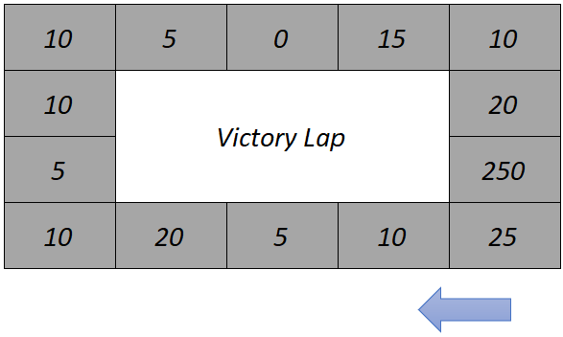

Rules:
Start on the 25 tile
Roll a 6-sided dice to move
You win the amount shown on every square you land on
Game ends after 4 rolls
Or, game ends if you land on 0
abcdefghijklmnopqrstuvwxyz1234567890=_+{[}]#~’@;:/?.>,<|\`¬*
abcdefghijklmnopqrstuvwxyz1234567890=_+{[}]#~’@;:/?.>,<|\`¬*
i
i
i
i
i
Check in R
i
Bonus Game
Example Game
Slot Machines
abcdefghijklmnopqrstuvwxyz1234567890=_+{[}]#~’@;:/?.>,<|\`¬*

Slide 5
1
Winnings:
25 + 20 = 45
Dice Roll :
abcdefghijklmnopqrstuvwxyz1234567890=_+{[}]#~’@;:/?.>,<|\`¬*
2
Winnings:
45 + 10 = 55
Dice Roll :
3
Winnings:
55 + 10 = 65
Dice Roll :
4
Winnings:
65 + 250 = 315
abcdefghijklmnopqrstuvwxyz1234567890=_+{[}]#~’@;:/?.>,<|\`¬*
Dice Roll :
i
i
i
i
i
Check in R
i
Markov Chains
Bonus Game
Slot Machines
Example Game
abcdefghijklmnopqrstuvwxyz1234567890=_+{[}]#~’@;:/?.>,<|\`¬*

Slide 6
Used to find probabilities of sequences of events
The probabilities of the next event depend only on the current event.
abcdefghijklmnopqrstuvwxyz1234567890=_+{[}]#~’@;:/?.>,<|\`¬*
abcdefghijklmnopqrstuvwxyz1234567890=_+{[}]#~’@;:/?.>,<|\`¬*
i
i
i
i
i
Check in R
i
Bonus Game
Slot Machines
Model Making
Markov Chains
Example Game
abcdefghijklmnopqrstuvwxyz1234567890=_+{[}]#~’@;:/?.>,<|\`¬*

Slide 7
For each tile, found the probabilities of landing on every other tile
Found the probability of being on each tile after 1 step
Iterated over 4 steps
Tweaked model to achieve desired pay-out
abcdefghijklmnopqrstuvwxyz1234567890=_+{[}]#~’@;:/?.>,<|\`¬*
abcdefghijklmnopqrstuvwxyz1234567890=_+{[}]#~’@;:/?.>,<|\`¬*
i
i
i
i
i
Check in R
i
Bonus Game
Example Game
Slot Machines
Model Making
Markov Chains
abcdefghijklmnopqrstuvwxyz1234567890=_+{[}]#~’@;:/?.>,<|\`¬*

Slide 8
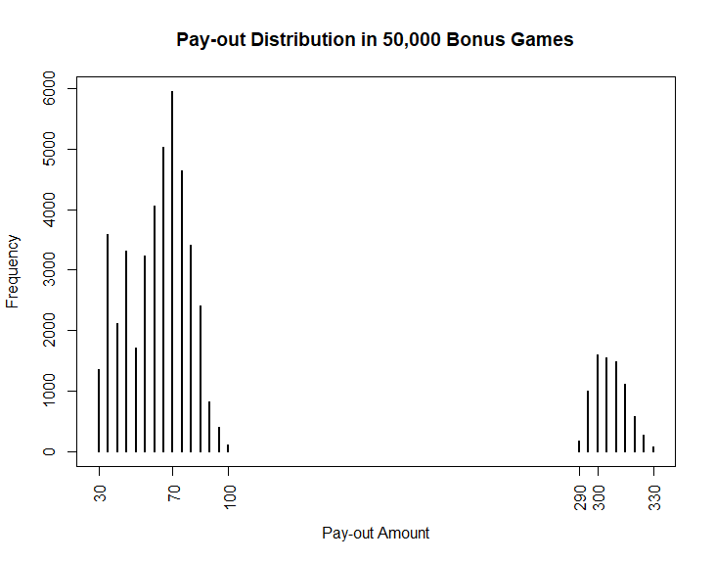
Built bonus game in R
Performed Monte Carlo Simulation to check expected value of pay-outs
i
i
i
i
i
i
Check in R
Bonus Game
Markov Chains
Example Game
Slot Machines
Model Making

Slide 9
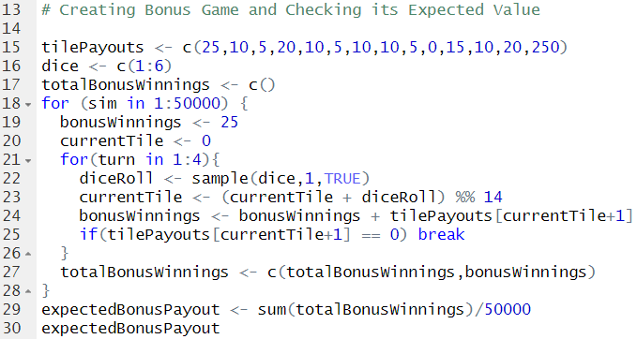
Appendix Bonus Game Code:
abcdefghijklmnopqrstuvwxyz1234567890=_+{[}]#~’@;:/?.>,<|\`¬*
abcdefghijklmnopqrstuvwxyz1234567890=_+{[}]#~’@;:/?.>,<|\`¬*
i
i
i
i
i
i
Bonus Game
Check in R
Example Game
Model Making
Markov Chains
Slot Machines
abcdefghijklmnopqrstuvwxyz1234567890=_+{[}]#~’@;:/?.>,<|\`¬*

Slide 10
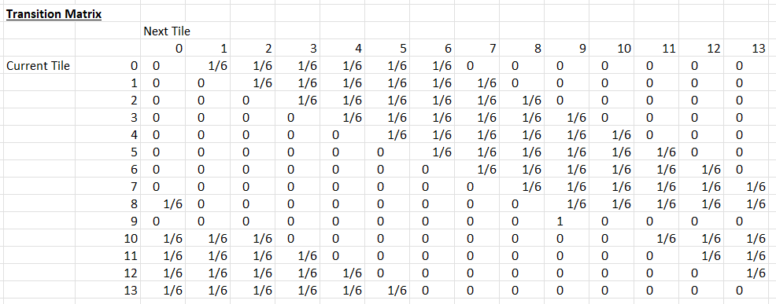
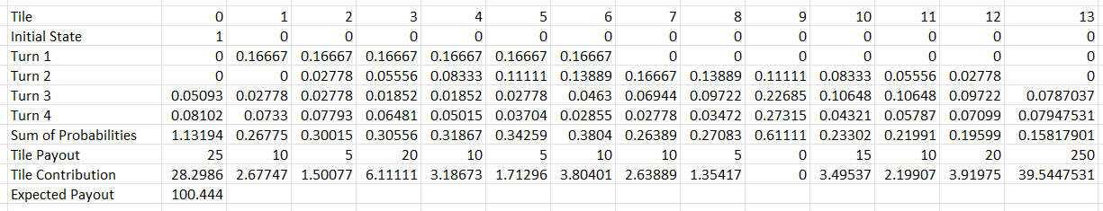
Appendix Markov Chain Transition Matrix:
Pay-out Calculation:
abcdefghijklmnopqrstuvwxyz1234567890=_+{[}]#~’@;:/?.>,<|\`¬*
abcdefghijklmnopqrstuvwxyz1234567890=_+{[}]#~’@;:/?.>,<|\`¬*
i
i
i
i
i
i
Bonus Game
Check in R
Example Game
Model Making
Markov Chains
Slot Machines
abcdefghijklmnopqrstuvwxyz1234567890=_+{[}]#~’@;:/?.>,<|\`¬*

